Slide 1
Visualization Based TechnicaL Presentation on Growth Functions: An Analysis of Algorithm Efficiency Using Big-O Notation
GUIDED BY PRESENTED BY
Dr.G.Nagarajan
M.Gowtham kumar

Slide 2
Introduction
Growth functions describe how an algorithm's execution time increases with input size (n).
They are represented using Big-O notation.
Used to measure the efficiency and scalability of algorithms.
Help compare the performance of different algorithms.
Important for selecting the best algorithm for a given problem. Common growth functions include O(log n), O(n), O(n log n), O(n²), and O(2ⁿ)

Slide 3
Required Materials
Hardware
Computer or Laptop
Projector (for presentation)
Software
Microsoft PowerPoint / Google Slides
Microsoft Excel or Google Sheets
Python (Matplotlib) or MATLAB (optional)
Visualization Tools
Tables
Line Graphs
Charts
Big-O Growth Function Data
Growth Functions Analyzed : O(log n), O(n), O(n log n), O(n²), O(2ⁿ)

Slide 4
Problem Statement
Algorithms perform differently as input size increases.
Inefficient algorithms require more execution time and memory.
Large datasets demand highly efficient algorithms. Comparing growth functions helps identify scalable algorithms.
Visualization makes performance differences easier to understand.
The study aims to relate growth behavior to algorithm selection.

Slide 5
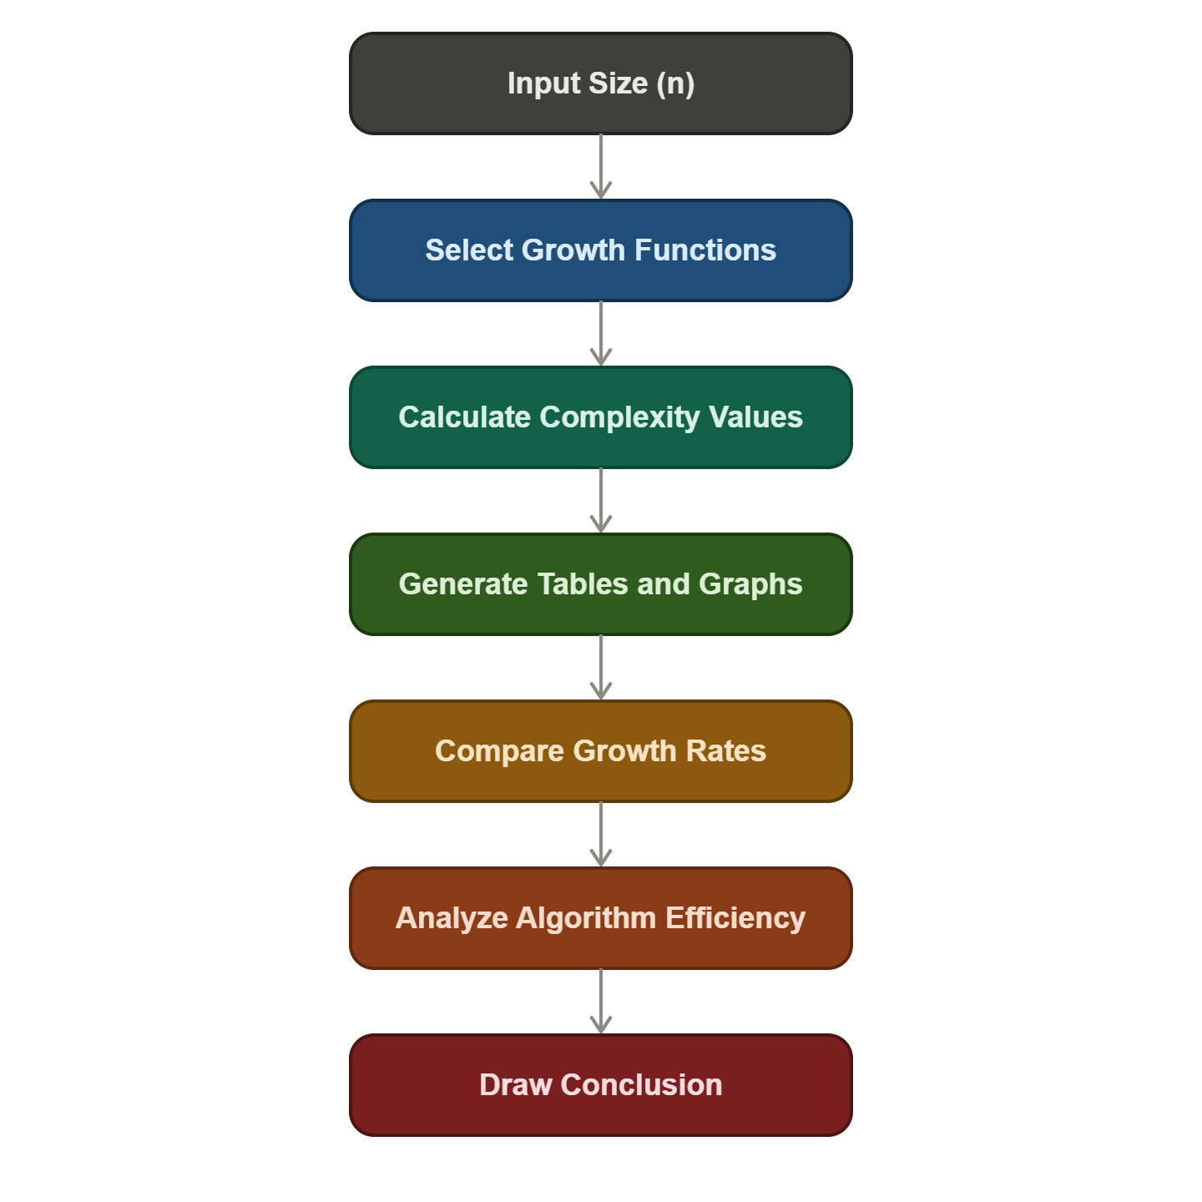
System architecture

Slide 6
Results
O(log n) grows very slowly and is the most efficient.
O(n) increases linearly and performs well for large datasets.
O(n log n) provides excellent performance for sorting algorithms.
O(n²) grows rapidly and becomes inefficient for large inputs.
O(2ⁿ) grows exponentially and is impractical for large-scale problems.

Slide 7
Conclusion
Growth functions help evaluate algorithm efficiency.
Lower growth rates lead to better scalability.
O(log n) is the most efficient for large datasets.
O(n) and O(n log n) are widely used in practical applications.
O(n²) should be limited to small datasets.
O(2ⁿ) should be avoided unless no better algorithm exists.
Choosing the right algorithm improves performance, reduces execution time, and optimizes resource usage.

Slide 8


